Slide 1
Bar Hopper
System Architecture & Requirements

Slide 2
System Architecture

Slide 3
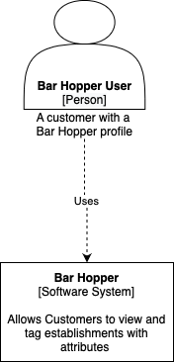
System Architecture - Context Diagram

Slide 4
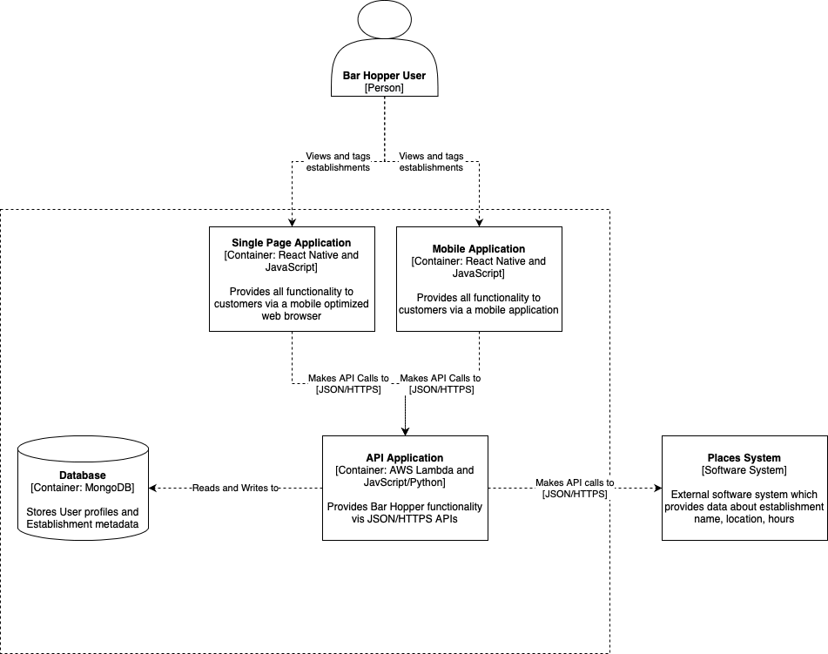
System Architecture - Container Diagram

Slide 5
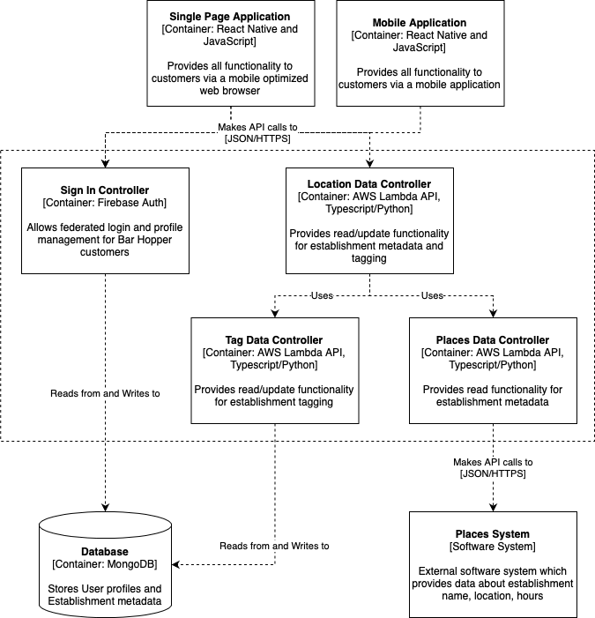
System Architecture - Component Diagram

Slide 6
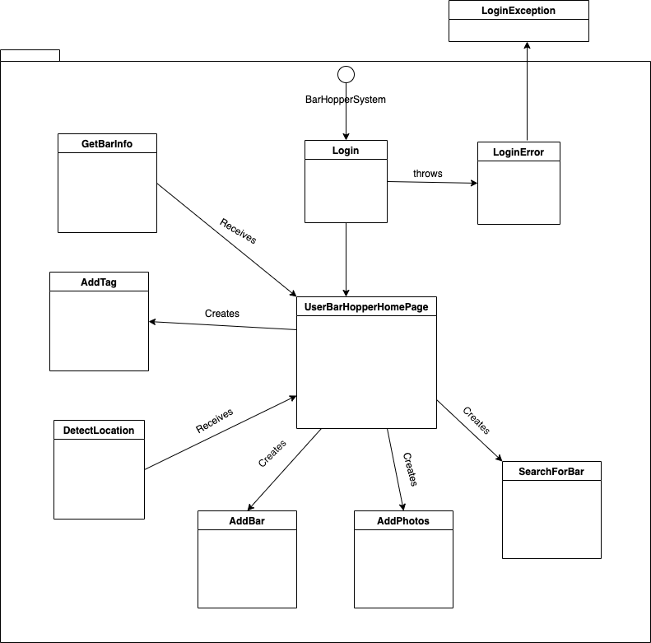
System Architecture - Code Level

Slide 7
System Requirements

Slide 8
System Requirements
Mission Statement
The Bar Hopper app will maximize users’ nightlife and increase nightlife establishment’s patronage in the wake of the Covid-19 pandemic.
Key Stakeholders
Bar Hoppers
Maximize nightlife by finding bars/clubs that best fit mood
Establishments
Gain customers, increase notoriety, promote positive reputation, increase profit

Slide 9
System Requirements
Key Drivers
After over a year and a half of a global pandemic and as covid-19 social restrictions begin to lift, people are eager to socialize and reenter the night scene. Bar Hopper will not only assist in the transition back to nightlife, but will improve upon the process by:
Conveying current bar/club line wait times
Conveying covid-19 regulations/restrictions (vaccinations, masks, etc.)
Conveying characteristics like atmosphere, crowd level, etc.
Conveying a bar/club’s rating
Allowing users to give real-time updates of the above info
Allowing users to conduct a filtered search to select a bar that fits their mood, time, and safety concerns
By addressing these issues, Bar Hopper will reduce frustration and increase satisfaction. Bar Hopper will empower users to make choices that are right for them at a bar that is right for them!

Slide 10
Business Requirements
The app shall attract 10,000 customers per quarter.
The app shall attract customers aged 21-40 in the first quarter.
The app shall operate in major cities.
The app shall increase bar/club patronage by 25% in the first quarter.

Slide 11
System Requirements
The system shall be available to access as a WebApp optimized for mobile layouts and Mobile App.
If the system is accessed as a WebApp, it shall render in Chrome, Safari, and Firefox.
The system shall be available for download on iOS and Android devices and render on all screen sizes.
The application shall render the map and all locations meeting search criteria in under 1 second.
The system shall support 1,000 users concurrently accessing the application.

Slide 12
Security Requirements
Customer profiles shall only be logged into through federated AuthN services.
Infrastructure shall only be accessed by system administrators.

Slide 13
Quality Requirements
The system shall support 1,000 concurrent users.
The system shall maintain four 9s of availability
The system shall retain data for at least one year

Slide 14
User Stories
As a bar hopper, I want to be able to create a profile through either Google or custom email and password so I can login, add tags, etc.
As a bar hopper, I want to be able to see tags for each bar/club on the map so that I can decide where to go
As a bar hopper, I want to be able to see the bar information such as name, location, hours, numbers, vaccine protocols, top photos, and tags so that I can decide where to go
As a bar hopper, I want to be able to tag a bar with one of the tags so that I can help other decide where to go
As a bar hopper, I want to be able to identify the vibe of the bar so that I can help other bar hoppers decide where to go
As a bar hopper, I want to be able to add photos so that other bar hoppers can see what's going on
As a bar hopper, I want to be able to see a map centered on my location so that I can see the bars/clubs within 5 miles of my location

Slide 15
Any Questions?

